Slide 1
9.4/9.5 Orbital Overlap and Hybrids
Honors Chem 2019

Slide 2
9.4 Overlap
VSEPR theory explains the results of experimentation (bond angles, formulas)
But it does not necessarily explain why bonds exist between atoms
This problem has been approached from the direction of quantum mechanics
For this topic, we need to think back to chapter 6 and the shapes of molecular orbitals

Slide 3
9.4 Overlap
In Lewis’s notion of bonding, two electrons are shared between the nuclei of neighboring atoms
In valence bond theory (similar to Lewis) electrons in neighboring orbitals, build up electron density
This is visualized best by two neighboring orbitals sharing a region of space and overlapping
This gives electrons with opposite spin to share a common space and form a covalent bond

Slide 4
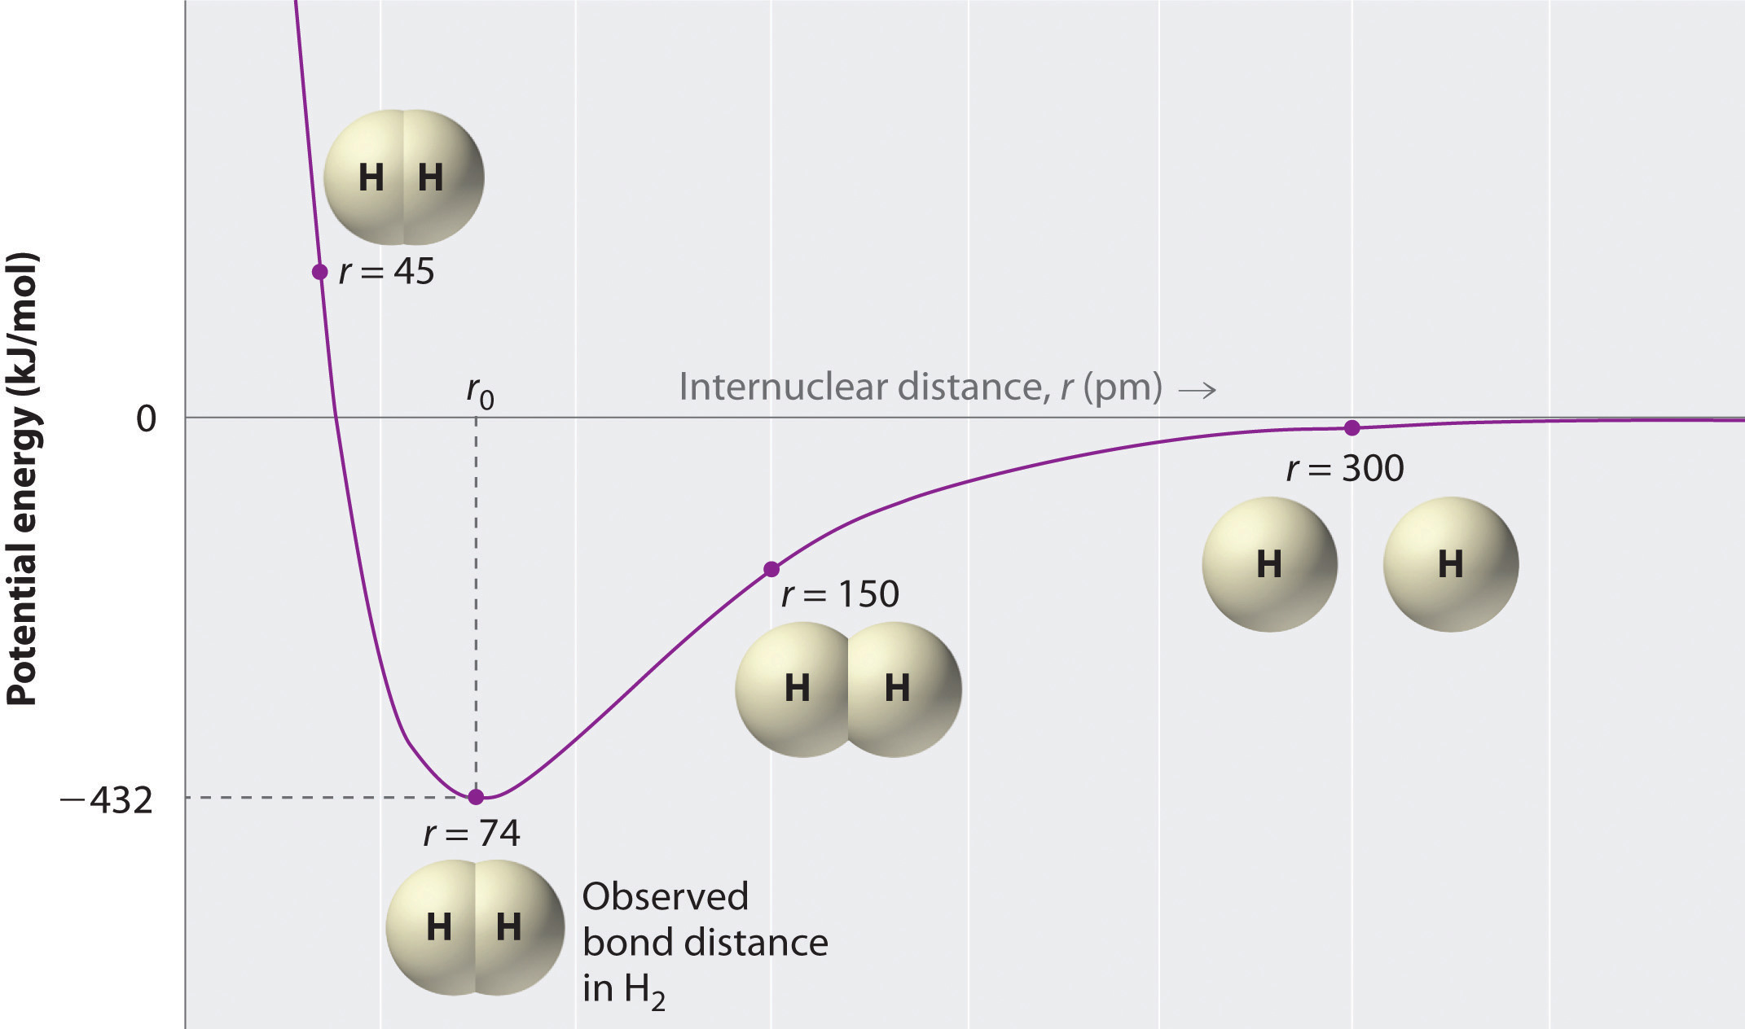
9.4 Overlap
What defines the optimal distance for a bond?
Optimal distance exists where the potential energy between the bonds is the lowest, which corresponds to the energy of formation to bonds

Slide 5
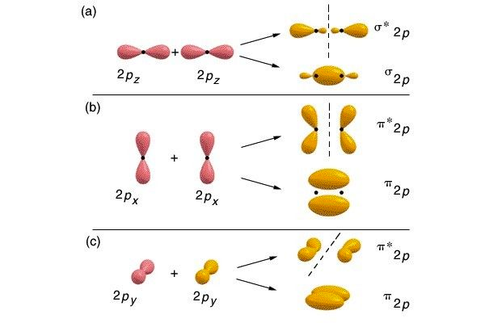
9.4 Orbital Shapes and Overlap

Slide 6
9.5 Hybrid Orbitals
So while overlap allows us to easily understand covalent bonding…
Extending the idea to molecular shapes of polyatomic molecules, is not as easily explained
For example, CH4 has bond angles that do not align with the x, y, and z axis of normal p orbitals
Therefore, there must be some other concept at play that explains geometries

Slide 7
9.5 Hybrid Orbitals
To explain geometries, we often assume that during bonding, atomic orbitals in an atom mix to form hybrid orbitals
However, the total number of orbitals on an atom remains constant, therefore the # of hybrid orbitals on an atom equals the number of atomic orbitals mixed
During this section, we will examine the most common electron geometries predicted by the VESPR model
linear, trigonal planar, and tetrahedral

Slide 8
9.5 Hybrid Orbitals (sp)
Let’s consider BeF2
Lewis structure predicts that this molecule is linear due to no lone pair and the identical atoms bound to fluorine
Fluorine seeks to fill its 2p orbital which has a lone unpaired electron
What which orbitals overlap in Be and why?
Orbitals hydqidize because they can direct the lobes of their orbitals towards other atoms to form stronger bonds

Slide 9
9.5 Hybrid Orbitals (sp)
Beryllium normally has 2 electrons in a filled 2s orbital
However, because BeF2 exists, we seek to explain not only the bonding, but the linear shape as well
Beryllium, according to valence bond theory, promotes a 1s electron to a 2p orbital, and creates new orbitals with identical shapes and equivalent energies

Slide 10
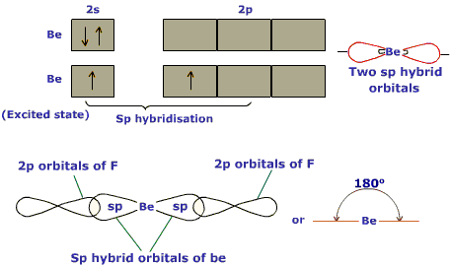
9.5 Hybrid Orbitals (sp)
The new orbitals are considered a hybrid orbital or sp because it mixes one s and one p orbital
A linear arrangement, always, implies sp hybridization

Slide 11
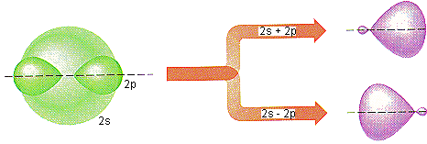
9.5 Hybrid Orbitals

Slide 12
9.5 Hybrid Orbitals (sp2 and sp3)
Whenever we mix a specified number of orbitals, we get the same number of hybrid orbitals
Each new set of orbitals is equivalent to the others, just points in different directions
Let’s take a look at BF3 orbital hybridization
Just like BeF2, in BF3, Boron must promote s orbital electrons to create new hybrid orbitals

Slide 13
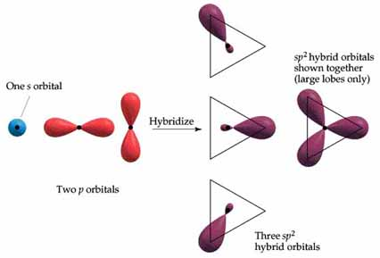
9.5 Hybrid Orbitals (sp2 and sp3)
When one s and two p orbitals are mixed, we get sp2 hybridization
In sp2 hybridization, trigonal planar geometry arises

Slide 14
9.5 Hybrid Orbitals (sp2 and sp3)
An s orbital can also mix with three p orbitals in the same subshell
For example the carbon atom in CH4 forms 4 equivalent bonds with the 4 hydrogen atoms
The 2s electrons are promoted and the orbitals are mixed to create sp3 (read s p three) hybrid orbitals

Slide 15
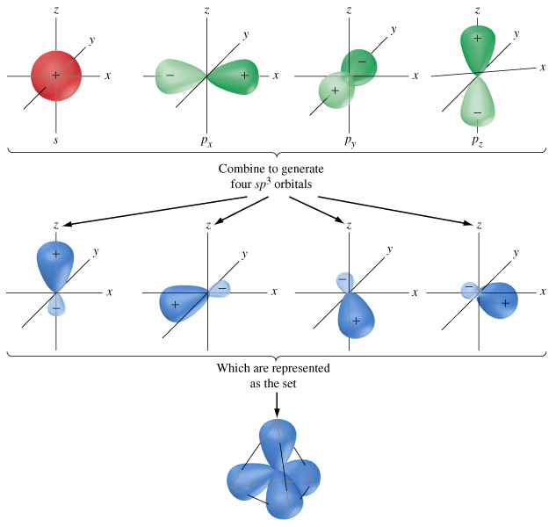
9.5 Hybrid Orbitals (sp2 and sp3)

Slide 16
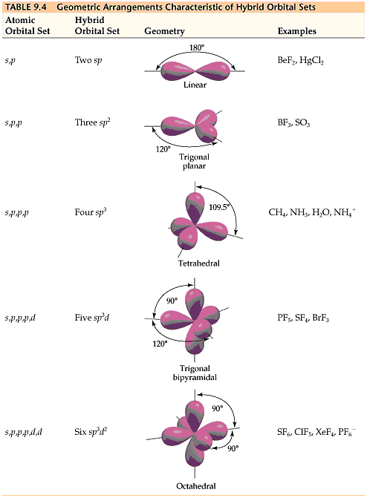
9.5 Hybrid Orbitals Chart

Slide 17
9.4 and 9.5 Summary
Valence bond theory and hybrid orbitals create a convenient way to explain molecular geometries who conform to VSEPR theory
Predicting bond orbital hybridization occurs in 3 steps
1. Draw the lewis structure for the molecule or ion
2. Determine the electron geometry using the VSEPR model
3. Specify the hybrid orbitals needed to accommodate the electron pairs based on the geometric arrangement

